Slide 1

NICHE PROJECTS

Slide 2
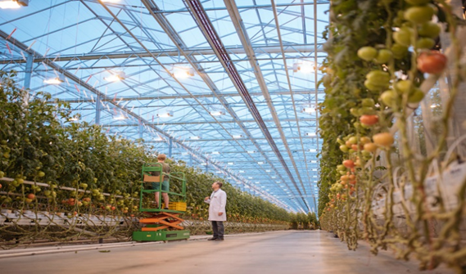

FLOWER-GREENHOUSE COMPLEX
Region: Aktobe region.
Industry: Agro-industrial complex.
Company name: «Orange Holding» LLP.
Project cost: $ 74 million.
Project capacity: Dutch roses – 12 960 000 per year; tomatoes - 3 672 tons per year; cucumbers - 5,184 tons per year; Bulgarian pepper (paprika) - 1,080 tons per year; salad greens - 432 tons per year; strawberries - 648 tons per year; potted flowers - 222,300 pieces per year; tulips - 900 000 pieces per year.
Workplaces: 50-60.
Competitive advantages or uniqueness of the project: ---
Type of project implementation (new, expansion, next stage, reinvest, greenfield & brownfield): New project.
Project status: The initiator of the project has the land plot. Documentation is developed. To start the construction and installation works, financing is needed.
Contacts of Kazakh Invest:
Regional director
Sagyn Bekbol
8 (700) 571 96 55
Director of the Department of Regional Development, Interaction and Monitoring Akhmetov Nurlan
+7 702 359 99 56

Slide 3
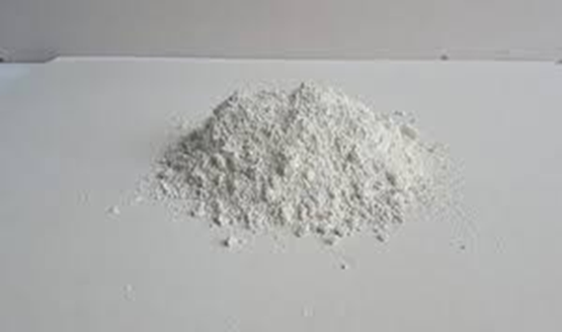
WET KAOLIN ENRICHMENT FACTORY
Region: Aktobe region.
Industry: Mining and metallurgical complexю
Company name: «Sazprom» LLP.
Project cost: $ 20 million.
Project capacity: 20 000 ton per year.
Workplaces: Determined.
Competitive advantages or uniqueness of the project: ---
Type of project implementation (new, expansion, next stage, reinvest, greenfield & brownfield): New project.
Project status: The project is included in the Entrepreneurship Map of the Aktobe region. There is a kaolin clay deposit, as well as a production base. The project is at the design stage. At the moment, the project is at the stage of registration of the land.
Contacts of Kazakh Invest:
Regional director
Sagyn Bekbol
8 (700) 571 96 55
Director of the Department of Regional Development, Interaction and Monitoring Akhmetov Nurlan
+7 702 359 99 56

Slide 4
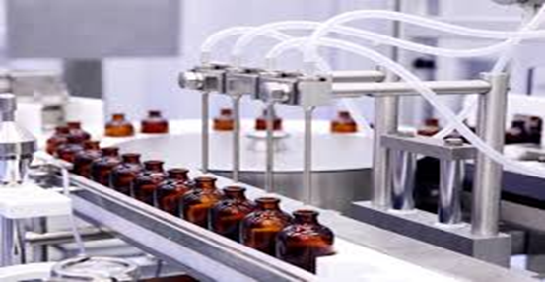
CONSTRUCTION OF A PHARMACEUTICAL FACTORY
Region: Atyrau region.
Industry: Pharmaceutics.
Company name: «Medicina» JSC.
Project cost: $59,8 million USD
Project capacity: Tablets - 12 000 000 pieces, capsules - 300 000 000 pieces, ampoules - 54 000 000 pieces, ointments - 12 000 000 packages, liquids - 16 000 000 bottles per year.
Workplaces: 50.
Competitive advantages or uniqueness of the project: The project is focused on import substitution, as well as on ensuring the uninterrupted production of high-quality pharmaceutical products, to meet the needs of all groups of population of the Western regions, as well as other regions of the Republic of Kazakhstan in medicines at affordable prices.
Type of project implementation (new, expansion, next stage, reinvest, greenfield & brownfield): New project.
Project status: The Design and estimate documentation is developed. Also, the positive conclusion of the Republican State Expertise «State out of departmental examination of projects» is received. At present, the zero cycle has been completed, work has begun on the construction of a block frame. The temporary premises of the office, rest of the builders and canteen were built. Construction has been suspended due to the problems of financing.
Contacts of the project initiator: Zabira Dauletzhanova, mobile: +7 701 566 26 40.
Contacts of Kazakh Invest:
Regional director
Yerzhan Kolbaev
8 (702) 638 88 43
Director of the Department of Regional Development, Interaction and Monitoring Akhmetov Nurlan
+7 702 359 99 56

Slide 5
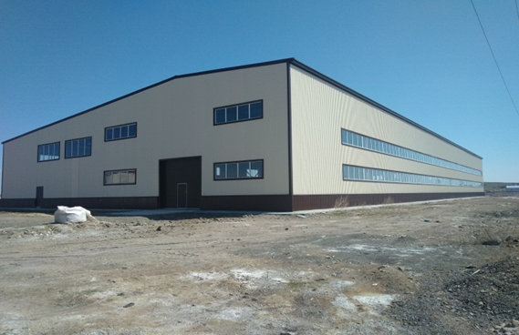
PLANT FOR THE PRODUCTION OF POLYMER CONCRETE PRODUCTS
Region: Karaganda region.
Industry: Construction industry.
Company name: «Otemis Ltd» LLP.
Project cost: $1 million USD
Project capacity: 5 000 tons per year.
Workplaces: 50.
Competitive advantages or uniqueness of the project: ---
Type of project implementation (new, expansion, next stage, reinvest, greenfield & brownfield): «Brownfield».
Project status: Construction of a plant for the production of polymer concrete products. It is possible to organize any production, depending on the wishes of the new owner (the production must correspond to the types of activities of the SEZ «Saryarka» - mechanical engineering, metallurgy, chemical industry, construction industry). Negotiations are underway with еру potential investors regarding the sale of the plant.
Contacts of Kazakh Invest:
Regional director
Madi Isekeyev
8 (701) 227 88 86
Director of the Department of Regional Development, Interaction and Monitoring Akhmetov Nurlan
+7 702 359 99 56

Slide 6

INCUBATION OF EGG CHICKENS
Region: Aqmola
Industry: Agro-industrial complex
Company name: «KazPlemPtica» LLP
Project description: Meeting the needs of domestic factories in chickens for eggs production, import substitution.
Project cost: $2,6 million USD
Manufactured production: incubation of egg chickens
Capacity: up to 4,5 million chickens per year
Number of workplaces: -
Type of project implementation: New
Project status: Applications for financing have been submitted to Bank Center Credit JSC/ Agrarian Credit Corporation JSC
Contacts of Kazakh Invest:
Regional director
Zholumbetov Yernur
8 (701) 526 19 99
Director of the Department of Regional Development, Interaction and Monitoring Akhmetov Nurlan
+7 702 359 99 56

Slide 7
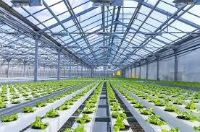
GREENHOUSE COMPLEX FOR GROWING VEGETABLES
ON PROTECTED GROUND
Region: Almaty
Industry: Agro-industrial complex
Company name: «Green House Almaty» LLP (BRB APK)
Project description : The project involves the expansion of production capacities and the construction of greenhouse on the territory of the Industrial Zone of Almaty in order to create an effective integrated business for growing vegetables and selling them on the market in Almaty, as well as the production of high-quality, competitive products using advanced proven technologies, supply and distribution for the development of the subsequent potential of the country in vegetable growing. There is a greenhouse on a plot of 12 hectares with a capacity of 5,800 tons per year of vegetable products. Raw materials (seeds and fertilizer) were purchased from Europe and Kazakhstan. Key advantages: the presence of an existing greenhouse, the availability of own funds in the amount of 9-10 million $
Project cost: $23,6 million USD
Project capacity: 5 800 tons per year of vegetable production
Workplaces: 105
Competitive advantages or uniqueness of the project: High quality products: storage up to two weeks, standard sizes, no pesticides and herbicides. According to technology: the service life of the greenhouse is 50+ years, the use of drip irrigation, water recirculation, convenient location with transport interchanges, optimal climatic conditions that do not require excessive costs for cooling the greenhouse whether it is in the South or heating whether it is in the North
Type of project implementation: Expansion
Project status: In progress
Contacts of Kazakh Invest:
Regional director
Mandibayev Berikbol
8 (747) 333 92 37
Director of the Department of Regional Development, Interaction and Monitoring Akhmetov Nurlan
+7 702 359 99 56

Slide 8
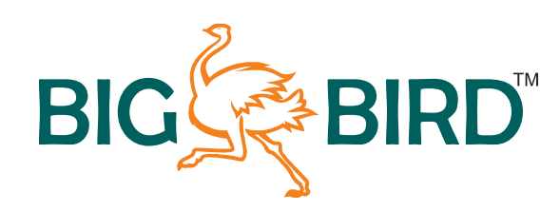
INDUSTRIAL BREEDING OF OSTRICHES AND PROCESSING
OF OSTRICH MEAT
Region: Almaty region
Industry: agro-industrial complex
Company name: «DOC» LLP
Project description : breeding and processing of ostrich meat
Project cost: 30 millions of US dollars
Output Products:
Ostrich meat processing (~ 50 thousand heads) - 2 thousand tons / year;
Production of melange and dry egg powder - 500 tons / year;
Ostrich oil (fat) production - 250 thousand liters / year;
Dressing of genuine ostrich leather - 50 thousand m2 / year;
Production of bone meal for feed - 1 thousand tons / year.
Project capacity: 50 thousand goals
Workplaces: 50-150
Competitive advantages or uniqueness of the project:
Availability of own financial participation in the project in the amount of 20%
Convenient logistic location near Kapshagai city (60km from Almaty city), which satisfies the biological characteristics of birds, as well as technological and sanitary conditions.
Access to engineering infrastructure, including gas.
Type of project implementation: New
Project status: An agreement was reached with KLEIN KAROO INTERNATIONAL LTD (South Africa) on the participation in the project by technology. A search for an investor.
Contacts of Kazakh Invest:
Regional director
Ovsyannikova Daria
8 (707) 990 09 88
Director of the Department of Regional Development, Interaction and Monitoring Akhmetov Nurlan
+7 702 359 99 56

Slide 9
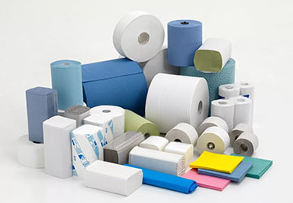
PRODUCTION OF PAPER PRODUCTS FOR SANITARY PURPOSES
Region: North-Kazakhstan Region
Industry: Processing industry
Company name: “Raduga” LLP
Project description: Organization of the production of paper products for sanitary purposes. A full cycle of waste paper processing to the manufacture of finished products. The production utilizes 70% of secondary raw materials and 30% of primary raw materials (cellulose and straw).
Project cost: $10,53 million USD
Project capacity: 25 tones per day or 500 tones per month
Workplaces: 30
Competitive advantages or uniqueness of the project: This project is interesting as an innovative business object, accumulating new jobs, satisfying the needs of the region and the country in paper products for sanitary purposes, with export potential. An important point is the location of the project: geographical proximity to cities with a population of over one million: Astana, Omsk, Kurgan, Chelyabinsk, Tyumen, which provides convenient access to a targeted, capacious sales market and cost-effective logistics. There is no similar production in the North Kazakhstan region
Type of project implementation: Greenfield
Project status: Business plan is ready. Local partner is looking for a financial support
Contacts of Kazakh Invest:
Regional director
Zhabagin Muratbek
8 (777) 777 99 91
Director of the Department of Regional Development, Interaction and Monitoring Akhmetov Nurlan
+7 702 359 99 56

Slide 10
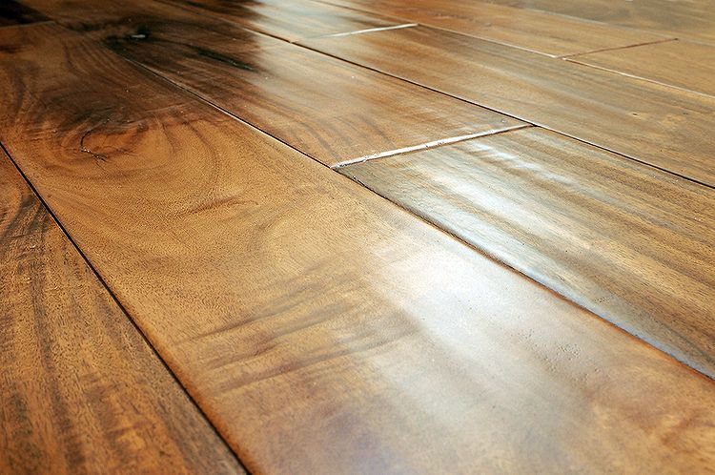
PRODUCTION OF PARQUET BOARDS AND FURNITURE
Region: Pavlodar region
Industry: Light industry
Company (initiator): StroiBioResurs LLP
Project overview: The project assumes production of high-quality parquet boards and furniture for export to the US market.
Project cost: 15-20 mln. USD
Product: high-quality parquet boards and furniture
Capacity of the project: 20 thous. m3
Number of workplaces: -
Competitive advantages or uniqueness of the project:
The existing woodworking enterprise. They produce furniture blanks (semimanufactures) and glued panels from solid birch, which have been successfully marketed in the Chinese market. Forest fund of Pavlodar region is 127.5 thousand ha. The annual volume of forest resources is from 10 to 15 thousand cubic meters. There is the possibility of increasing capacity due to the forest balance of the neighboring regions of Russia (the Novosibirsk forest fund is 6.49 million ha, Omsk - 5.95 million ha). The company plans to launch production of the end product, which is in high demand in the US market.
Type of project implementation: Expansion
Project status: Looking for strategic partner.
Contacts of Kazakh Invest:
Regional director
Daniyarov Madiyar
+7 701 397 61 71
Director of the Department of Regional Development, Interaction and Monitoring Akhmetov Nurlan
+7 702 359 99 56

Slide 11
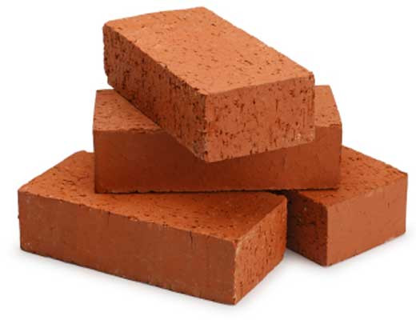
EXPANSION AND MODERNIZATION OF THE EXISTING BRICK FACTORY
Region: Zhambyl region
Branch: Construction Industry
Name of the company: «AyKo» LLP
Project Description: Production of building bricks and medical oxygen
Project cost: $20,4 million USD
Output products: clinker-pavers, roofing tiles, facade ceramic tiles, medical oxygen.
Project capacity: 40 million pieces of facial ceramic products
Workplaces: up to 150 people
Competitive advantages or uniqueness of the project: the field is unique in its kind, since the quality of raw materials is one of the best in the southern part of the Republic of Kazakhstan.
Type of project (new, expansion, the next stage, Reinvest, greenfield & brownfield): Expanding
Project status: There is a proven (YUZHKAZNEDRA) quarry, the Zhaksylyk loam deposit in the T. Ryskulov area (100 km from the Taraz city) with a reserve of 1.5 million cubic meters. loam suitable for brick production. To date, there is a plant for the production of building bricks of the M100 brand with an annual volume of 10,000,000 bricks per year with a total production base of 50 thousand square meters.
Contacts of Kazakh Invest:
Regional director
Gering Arnold
+7 778 929 64 32
Director of the Department of Regional Development, Interaction and Monitoring
Akhmetov Nurlan
+7 702 359 99 56

Slide 12
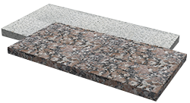
MODERNIZATION OF MARBLE MINING AND PROCESSING
Region: Zhambyl region
Branch: Construction Industry
Company name: «Azmina-marble» LLP
Project description: Modernization of the existing production for the extraction and processing of marble and the production of marble products
Project cost: $ 11.8 Million
Products: Marble products
Capacity of the project:
marble blocks: 10,000 cubic meters/year;
tile: 120 000 sq.m./year;
other products: 2,400 m3.
Number of work places: 50 people
Competitive advantages or uniqueness of the project: The enterprise is operating, production, processing and shipment of finished products to consumers is in progress.
Type of project implementation (new, expansion, next stage, reinvest, greenfield & brownfield): Expanding
Project status: The company produces 2 main and 2 side product type in marble deposit "Karatau": conditioning units, tiles, blades and other products made of marble. Conditioning units (i.e., without chipping and cracking) used for production of tiles, fireplaces, fountains, statues, railings, steps, etc. Tile has found wide application in finishing works (both internal and external). Dumps (substandard blocks) are used to make marble chips. To expand activities, equipment upgrades are needed. There is project documentation (business plan, feasibility study, design and estimate documentation)
Contacts of Kazakh Invest:
Regional director
Gering Arnold
+7 778 929 64 32
Director of the Department of Regional Development, Interaction and Monitoring
Akhmetov Nurlan
+7 702 359 99 56

Slide 13
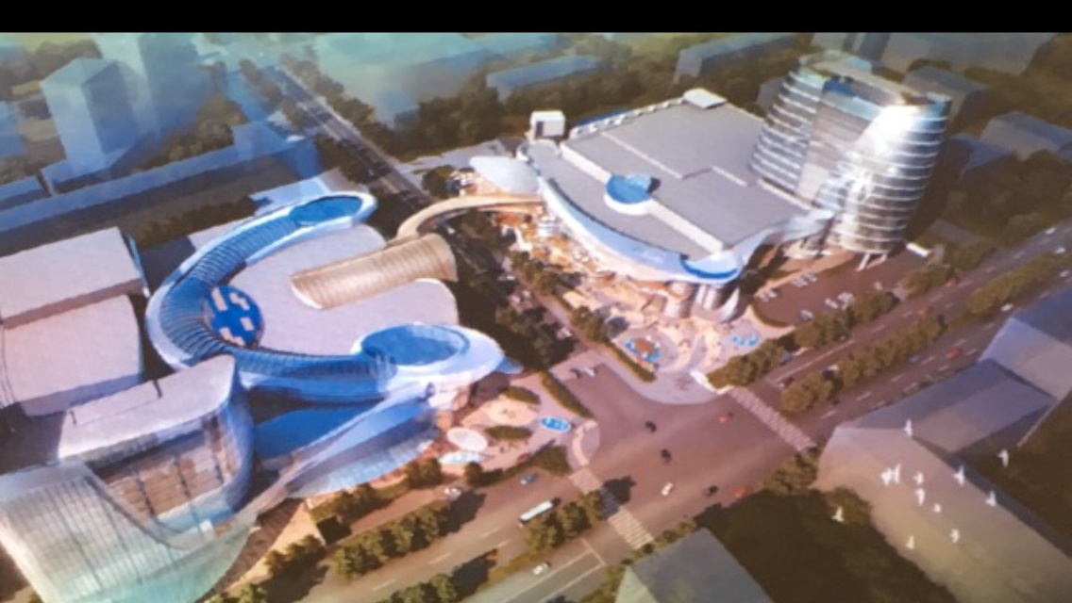
«CONSTRUCTION OF SHOPPING MALL»
Region: Shymkent
Отрасль: Tourism
Company name: DaniNan LLP (Kazakhstan)
Project description: Construction of a modern shopping mall (Mega Planet-TSUM complex)
Project cost: $100 million USD
Project capacity: -
Workplaces: -
Competitive advantages or uniqueness of the project: one of the largest shopping mall in Kazakhstan and Central Asia
Type of project implementation (new, expansion, next stage, reinvest, greenfield & brownfield): Expansion
Project status: Received state certificate for the unified land plot. Received architectural planning task. The design and estimate documentation is being implemented. The contractor is determined. The project initiator is ready to invest 25% of the project cost.
Contacts of Kazakh Invest:
Regional director
Kopaylov Igor
8 (701) 111 66 77
Director of the Department of Regional Development, Interaction and Monitoring
Akhmetov Nurlan
+7 702 359 99 56

Slide 14
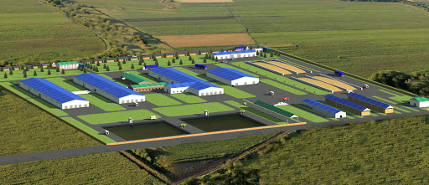
EXPANSION OF THE COMPLEX FOR GROWING CATTLE FOR 1200 HEADS AND A MILK PROCESSING PLANT
Region: Kyzylorda region
Industry: Agroindustrial complex
Company name: RZA JSC
Project description: The target group of the planned enterprise are residents of Kyzylorda region, as well as other regions of Kazakhstan. In the future, there are intentions to export manufactured products.
Project cost: $1 million USD
Manufactured production: Milk production
Project capacity: 3,5 thousand tons per year
Workplaces: 27 people
Type of project implementation (new, expansion, next stage, reinvest, greenfield & brownfield) : Expansion
Project status: Investor search in progress
Contacts of Kazakh Invest:
Regional director
Kulnazarov Rustem
8 (701) 757 94 08
Director of the Department of Regional Development, Interaction and Monitoring
Akhmetov Nurlan
+7 702 359 99 56

Slide 15
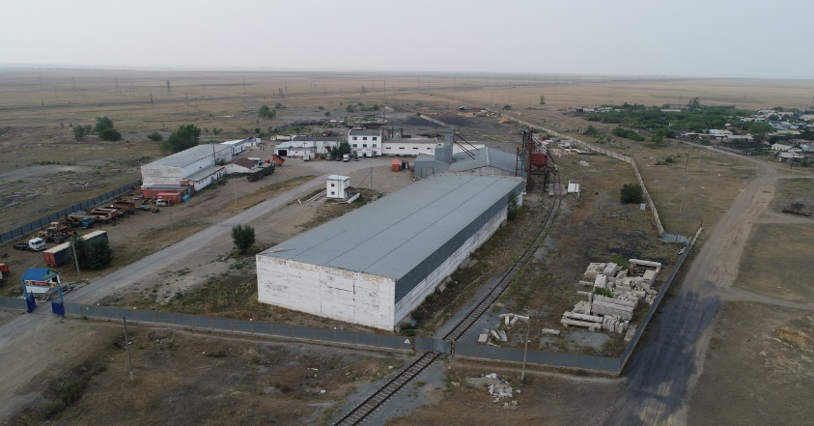
MODERNIZATION OF PRODUCTION OF MACARONI PRODUCTS, BAKERY PRODUCTS, AS WELL AS GRAIN PROCESSING (1st page)
Region: Kostanay region, Zhitikara city
Industry: Food industry
Company name: Ak-Mol LTD LLP
Project description:
Shipping services and the provision of storage facilities, trading services of grain crops.
The company accepts, stores and ships grain crops in conjunction with production lines. In addition, there is a production and technological laboratory. The laboratory is equipped with a viewing platform and the necessary equipment.
Production of flour, pasta, as well as bakery products.
About the mill:
Double Grain Mill;
Productivity - 60 tons per day;
Flour warehouse area - 500 sq.m;
Pasta: A high-quality product made from hard and soft wheat varieties. The equipment of the pasta shop is equipped with an Italian manufacturer. The capacity of the pasta shop is 100 kg per hour.
Bakery: bakery production capacity is 5,000 - 6,000 loaves of bread per day.
Contacts of Kazakh Invest:
Regional director
Amanbaev Ilyas
8 (705) 212 08 95
Director of the Department of Regional Development, Interaction and Monitoring
Akhmetov Nurlan
+7 702 359 99 56

Slide 16
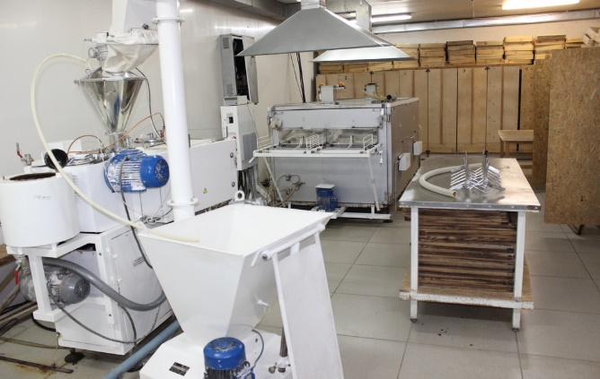
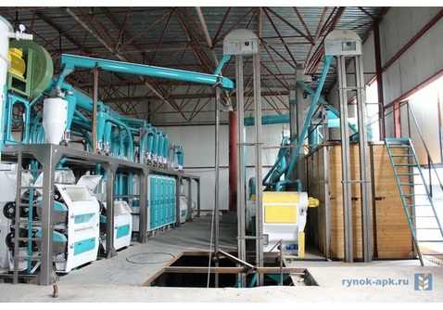
MODERNIZATION OF PRODUCTION OF MACARONI PRODUCTS, BAKERY PRODUCTS, AS WELL AS GRAIN PROCESSING (2nd page)
Project cost: $ 2 million USD
Manufactured production: flour, pasta and bakery products.
Project capacity: 18,000 tons of flour per year, 1,500,000 bakery products, 600 tons of pasta
Workplaces: 50 people
Sales market: Regions of Kazakhstan, Russian Federation, Central Asia
Competitive advantages or uniqueness of the project: High reputation of Ak Mol LTD LLP products, strategic location with Zhitikara railway station, 20 km to the border with the Russian Federation. High demand for food. Valid multi-year product supply contracts. Colossal experience in agriculture and food industry
Type of project implementation: Modernization, reinvest
Project status: Existing enterprise. On the balance sheet of the company there are production facilities - 10,000 thousand square meters, a land plot - 7 hectares, equipment, machinery, as well as all engineering and communications infrastructure (gas, electricity, water). Investments are needed to modernize equipment, consider opening new bakeries in the Kostanay region, as well as working capital for trading services of grain crops.

Slide 17
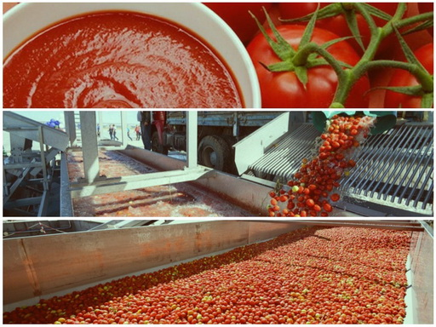
TOMATO PASTE PRODUCTION
Region: Turkestan region
Industry: Food industry
Company name: «Karabastau» LLP
Описание проекта: The project involves the construction of a plant for the production of tomato paste on the basis of "Karabastau" LLP, which has experience in growing tomatoes on an industrial scale.
Project cost: $23 million USD
Manufactured production: Tomato paste
Project capacity: 200 tons of tomato paste per day
Workplaces: 100 people
Competitive advantages or uniqueness of the project: Kazakhstan imports about half of the consumed tomato paste. Consumption of tomato paste in 2017 – 32 thousand tons. The local partner has ready-made acreage and necessary agricultural equipment on its balance sheet.
Type of project implementation: Greenfield
Project status: The search for an investor is underway
Contacts of Kazakh Invest:
Regional director
Mamyrov Dauletkozha
8 (707) 186 67 77
Director of the Department of Regional Development, Interaction and Monitoring
Akhmetov Nurlan
+7 702 359 99 56

